Slide 1
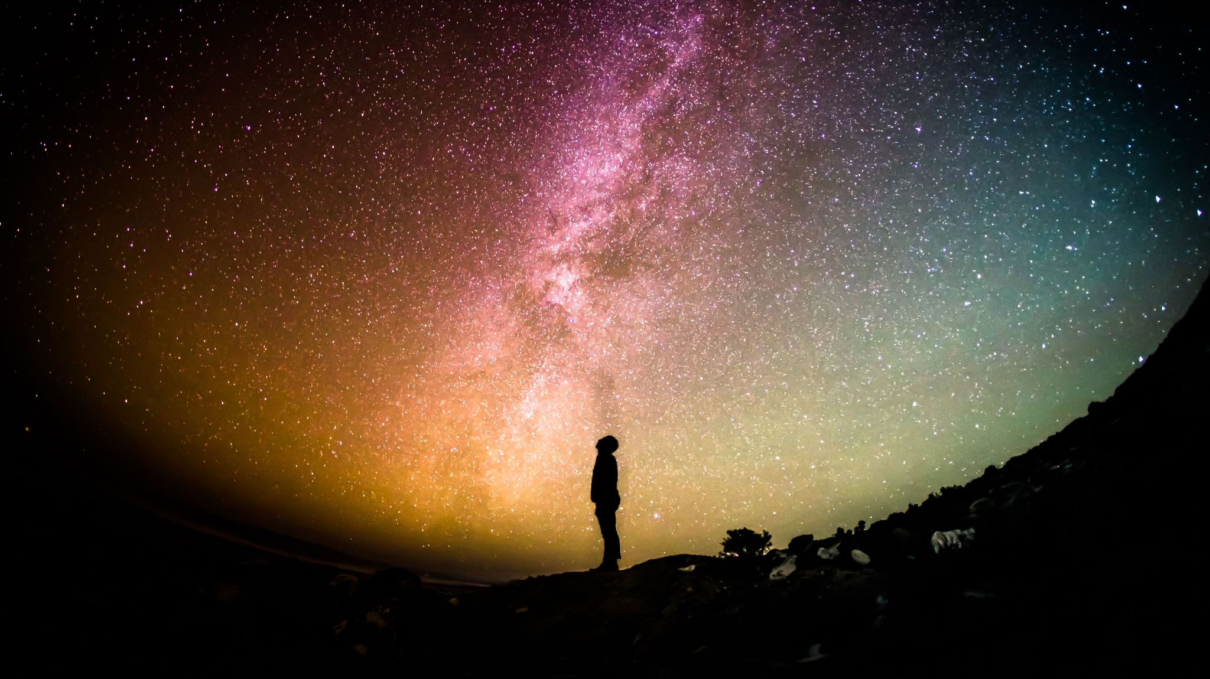
Consider the ways in which space exploration has affected our modern world. Discuss the financial impacts and consider whether this investment has been beneficial for science.
Ali Katani Zadeh
2598775

Slide 2
Structure:
3-introduction (stance)
4- Preventing disaster ( DART)
5-Preventing disaster ( Studying Venus )
6-Preventing disaster (greenhouse effect)
7-Improving life (periodic table)
8-Improving life (technological advancements)
9-Improving life (SMAP uses in Africa)
10-Is it worth it? (SMAP cost)
11-Is it worth it? (NASA budget)
12-Conclusions
13-References

Slide 3
Introduction:
The main objective of this PowerPoint will be to explain the importance of space exploration and how much it has helped improve human life.
This PowerPoint will also focus on rebutting the counter-arguments such as whether it is necessary to spend so much money on space exploration when we have problems on Earth.

Slide 4
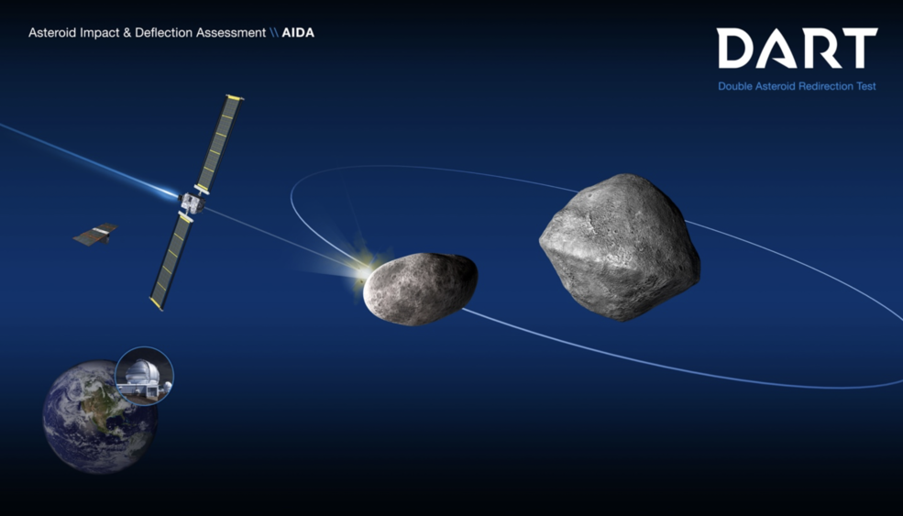
(DART) : Double asteroid Redirection test:
DART is a planetary defense test with the objective to redirect objects approaching Earth.
DART is one of NASA’s biggest projects for Extinction prevention.
DART will deflect asteroids by crashing into them to redirect them.
The DART spacecraft will launch in late July of 2021 aboard a SpaceX Falcon9 Rocket.
After over a year of cruise it will intercept Didymo's moonlet in late September 2022
Reference : https://www.nasa.gov/planetarydefense/dart

Slide 5
Studying Venus:
Studies on Venus have shown that Venus:
Almost same size as Earth
Almost same distance from Sun as Earth
However:
Venus has no magnetic fields
96.5% of its atmosphere is CO2
Has an atmosphere 90 times denser than Earth.
Has a temperature of 465 degrees Celsius.
Studies suggest this may be due to :
Runway greenhouse effect
Reference:
Byrne ( 2021 )

Slide 6
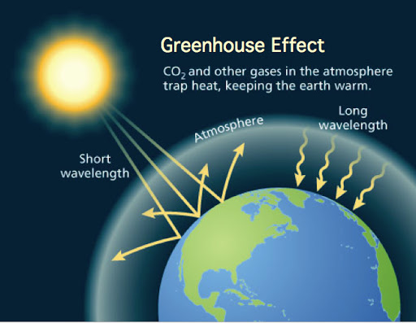
Greenhouse Effect:
The greenhouse effect is an effect where the sun’s heat is trapped withing the Earth’s atmosphere due to the greenhouse gases preventing the heat from going back into space.
Stephen hawking claims in his book “brief answers to the big questions” that this effect was recognized and identified due to space exploration and the shift of scientists to space.
Reference :
Stephen Hawking ( 2018 )
“brief answers to the big questions”

Slide 7
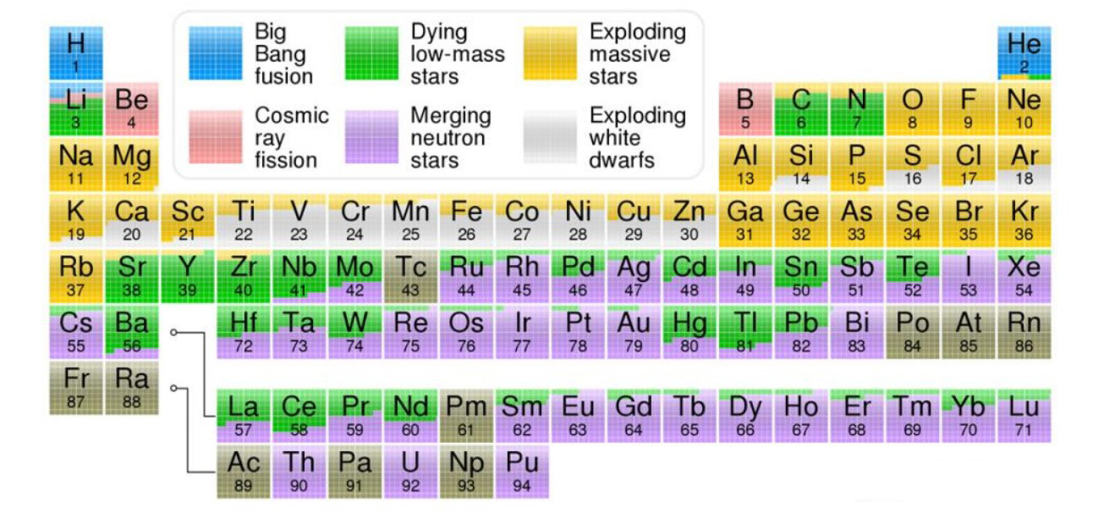
The Periodic Table:
Neil DeGrasse Tyson claims in his book “Astrophysics for people in a hurry” that some elements that can now be found on the periodic table were identified and discovered as a result of space exploration.
He also claims that if it was not for space exploration, humanity might have never discovered these elements or their origins.
Discovering these elements have helped humanity answer various questions and has helped in filling in gaps in the field of chemistry. This has also contributed to identify different elements that some compounds and molecules are made up of.
References:
Tyson (2017) “ Astrophysics for people in a hurry”
https://science.nasa.gov/where-your-elements-came

Slide 8
Technological advancements:
Space exploration has led to the introduction and addition of many inventions and tools in the daily life of humans such as:
The Internet
GPS
Artificial limps (shock absorbents)
References :
Spadoni (2020)

Slide 9
SMAP:
SMAP (Soil Moisture Active Passive) is a satellite that orbits Earth and has the objective and function of measuring soil moisture levels on Earth.
SMAP can measure the moisture levels of every patch of soil on Earth every 2-3 days. This can help predict floods and droughts.
Launched in 2015, stopped in may 2015 due to failure, was redeployed and has been collecting data ever since.
References :
Rober (2018)
Nasa.gov

Slide 10
SMAP Cost:
SMAP cost NASA a whopping $900million
However, if this same amount was used to feed Africa, it would feed them for less than a day.
SMAP works to teach and educate people the most efficient and productive ways of agriculture than could feed Africa for decades.
References :
Rober (2018)
Nasa.gov

Slide 11
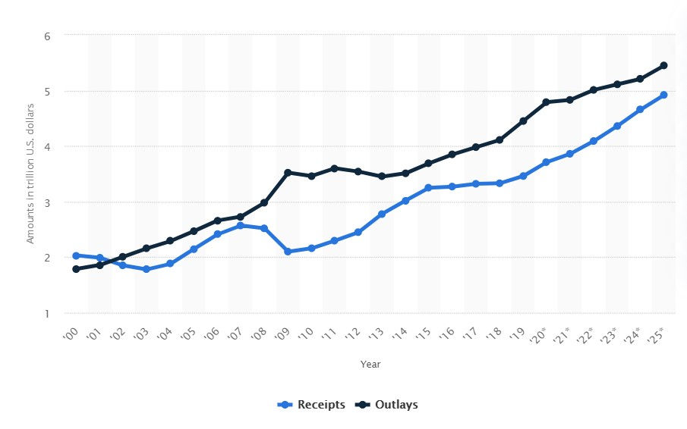
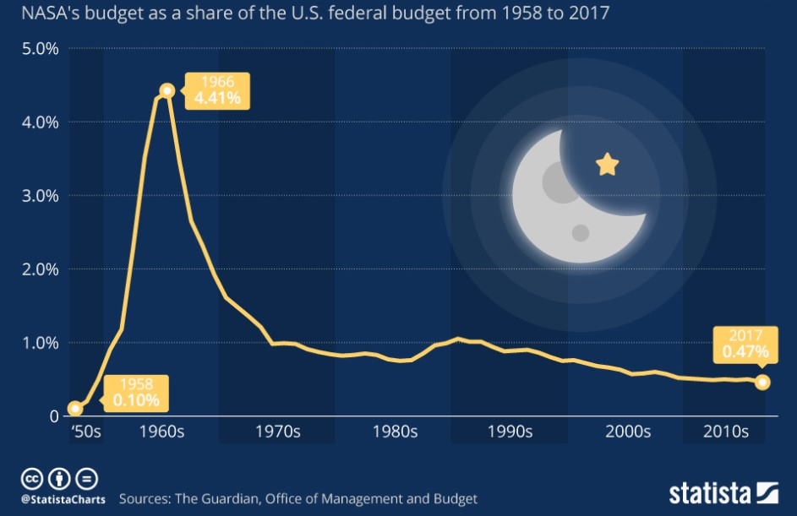
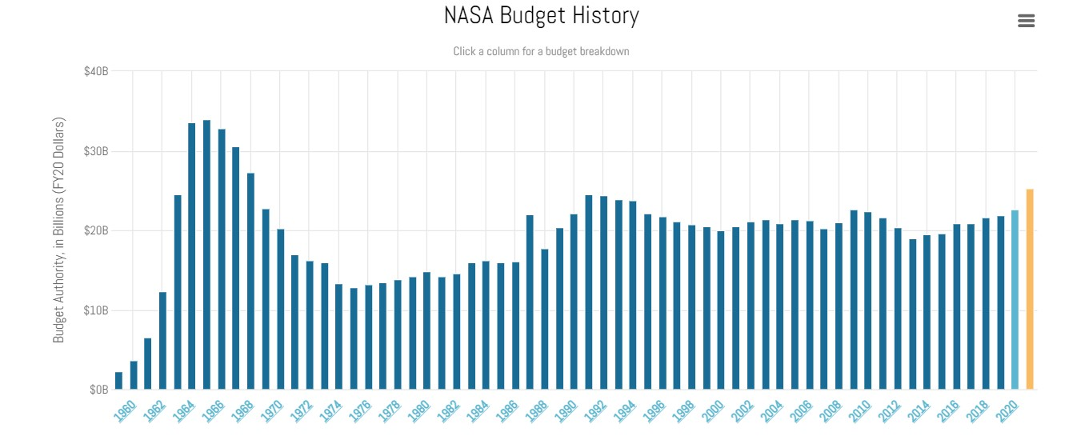
NASA’s Budget:
References :
Statista (2021)
https://aerospace.csis.org/data/history-nasa-budget/ (2021)

Slide 12
Conclusion:
To decide whether space exploration has been beneficial and worth the financial drawbacks, the benefits and improvements must be taken into consideration as well. Therefore, with the presence of this knowledge and with the knowledge of how helpful space exploration has been to human development, it can possibly be concluded by most people that space exploration has played a huge role in human development and knowledge and has saved humanity lots of money that would’ve been spent without solving certain issues. This could make space exploration a priority in research and studies of scientists in order to improve human life and prevent disaster more often in the near future.

Slide 13
References:
Slide 4 : Dunbar, B (2020) https://www.nasa.gov/planetarydefense/dart
Slide 5: Byrne, P. (2021) ‘Unveiling Earth’s Wayward Twin’ American Scientist pp.30-32 {article}
Slide 6: Hawking, S. (2018) “brief answers to the big questions pp.87-98 , 143-180 {book}
Slide 7: 1- Tyson, N. (2017) “Astrophysics for people in a hurry” pp.115 {book}
2- Johnson, J (2017) https://science.nasa.gov/where-your-elements-came
Slide 8: Spadoni, A. (2020) ‘How technology from the space race has changed the world” https://now.northropgrumman.com/how-technology-from-the-space-race-changed-the-world/ {article}
Slide 9 and 10: 1- Rober, M. (2018) “Is NASA a waste of money?” https://www.youtube.com/watch?v=lARpY0nIQx0&ab_channel=MarkRober
2- NASA (2021) https://smap.jpl.nasa.gov/
Slide 11: 1-Statista (2021) https://www.statista.com/chart/17504/nasas-budget-share-of-the-us-federal-budget/
and https://www.statista.com/statistics/222196/receipts-and-outlays-of-the-us-government-since-fiscal-year-2000/
2- Roberts, T. (2020) https://aerospace.csis.org/data/history-nasa-budget/

